Slide 1

FastQC
Bright Asante

Slide 2
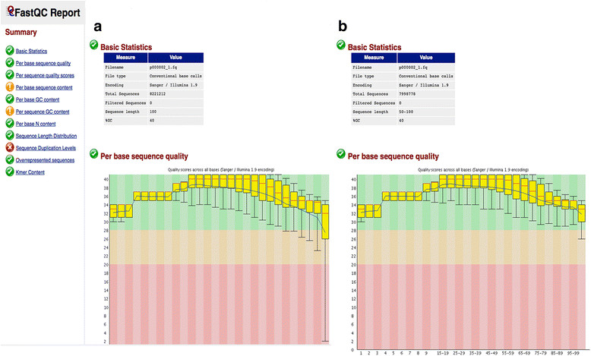
FastQC
Fast Quality Check/Control
FastQ files from sequencers
(i.e., raw sequence data)
Other Inputs
BAM
SAM files
Gzip compressed FastQ
Why FastQC
Sequencing errors
We want to be confident with our analysis

Slide 3
Running FastQC
FastQC requires Java installation
(java –- version), else install
Install, locate to directory
Unzip, change user permissions (usually chmod 755 fastqc whill do)
Eg: fastqc SRR3434990.fastq

Slide 4
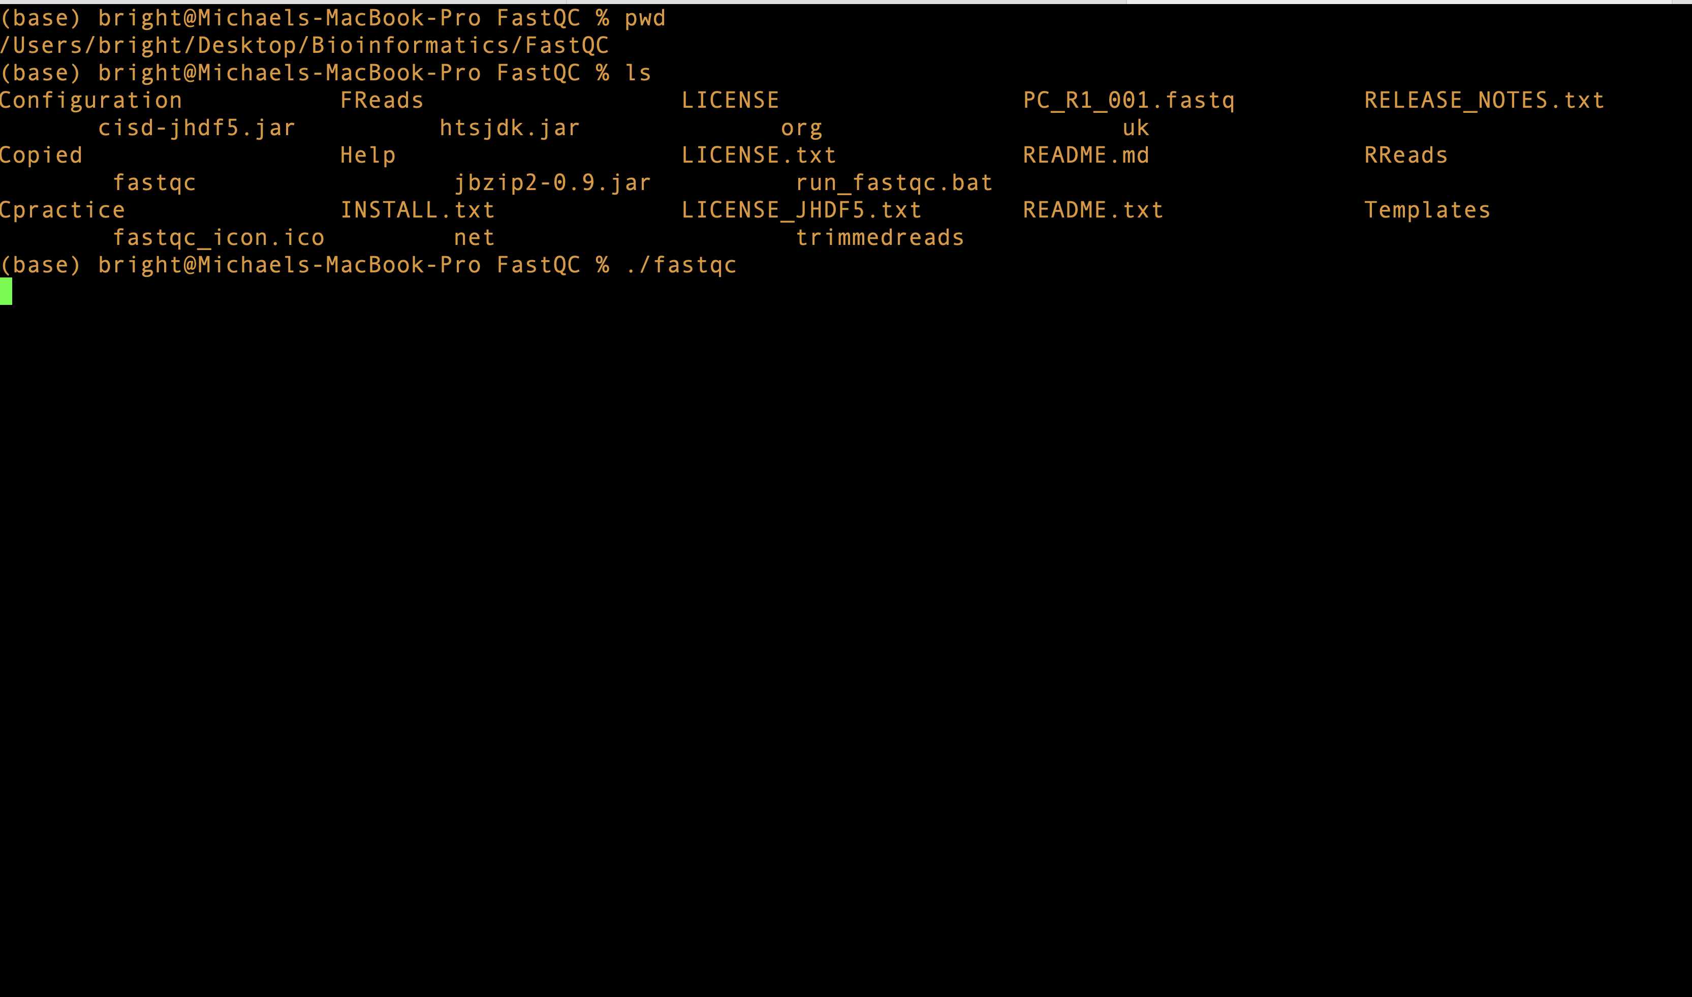
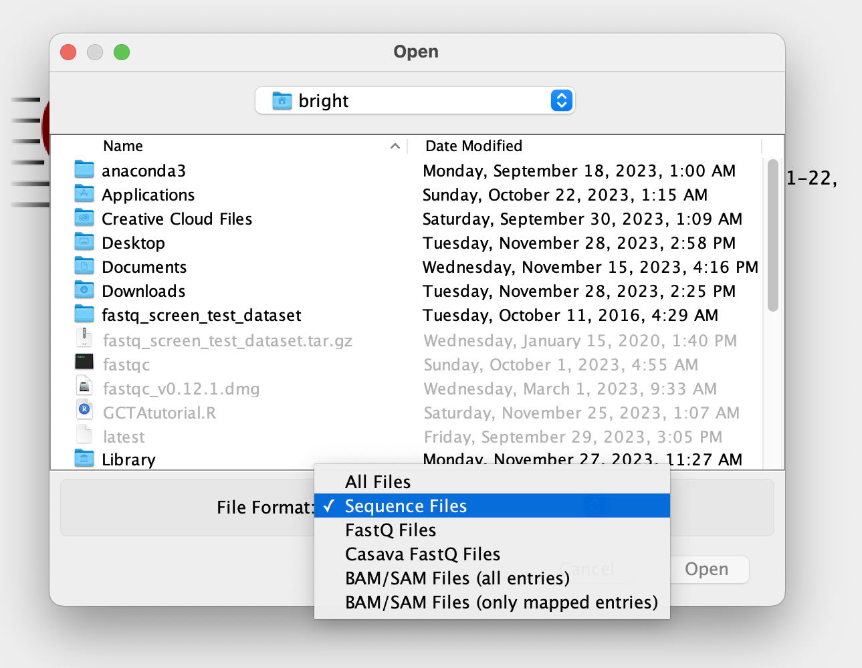
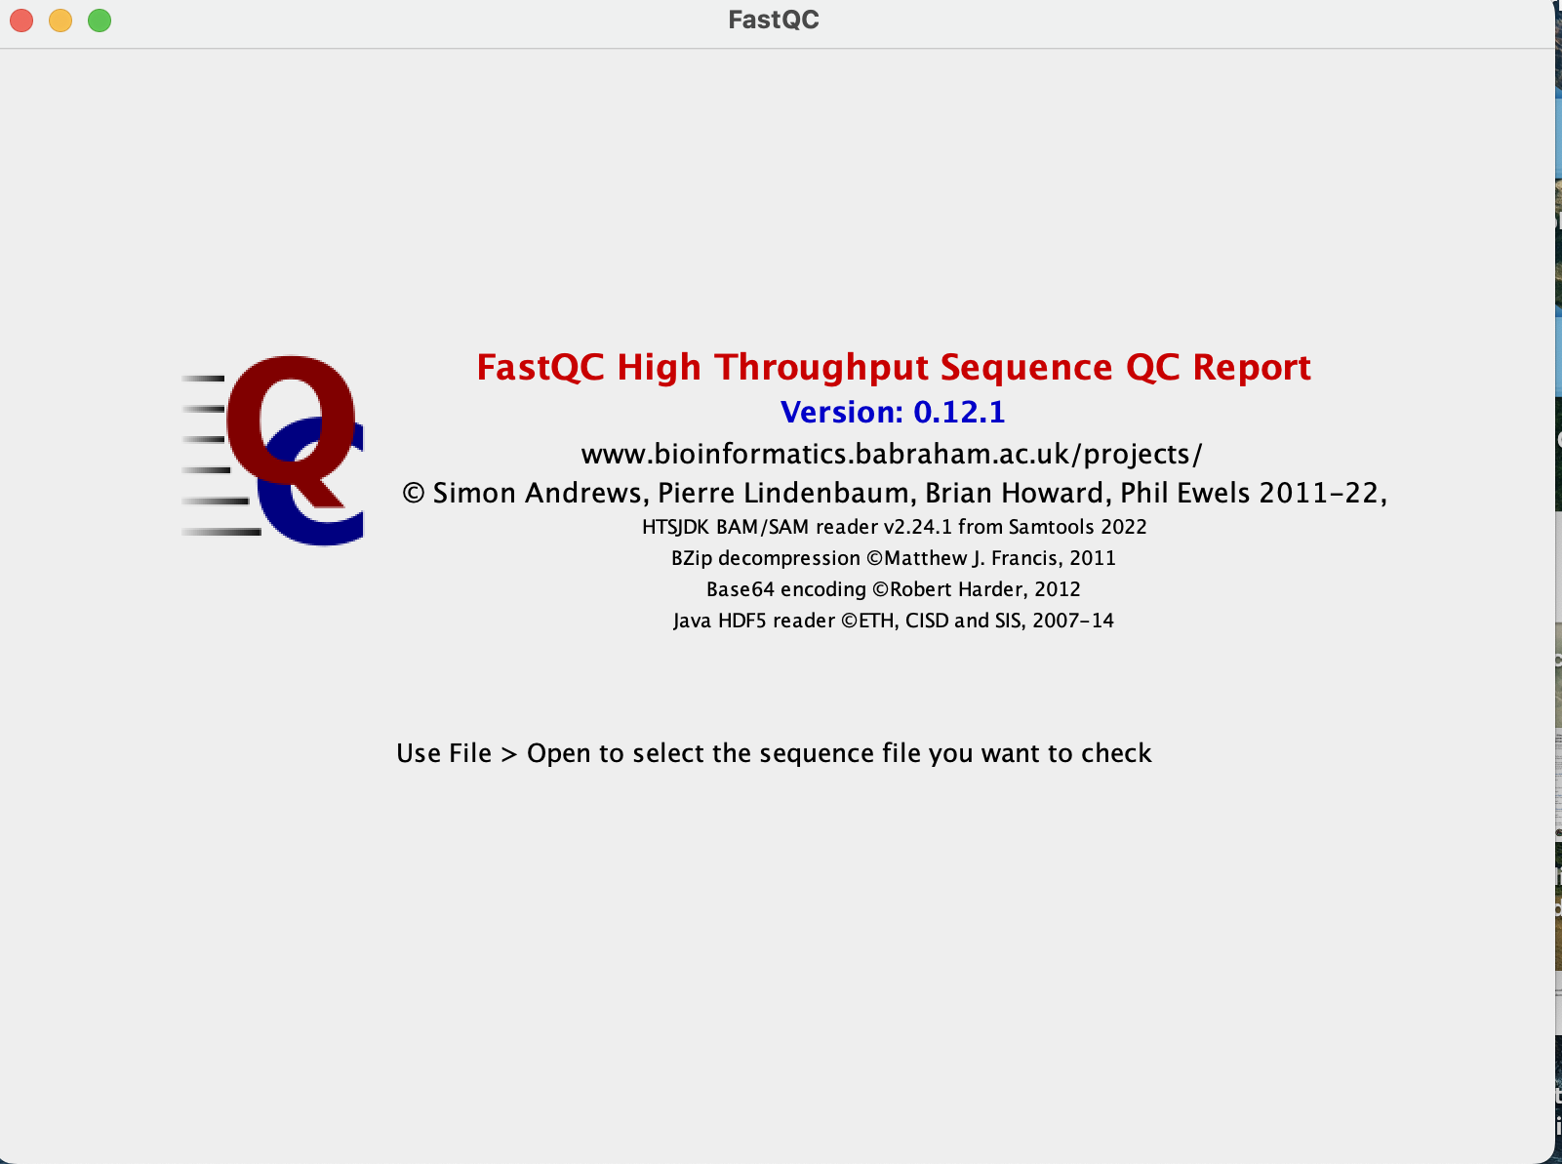

Slide 5
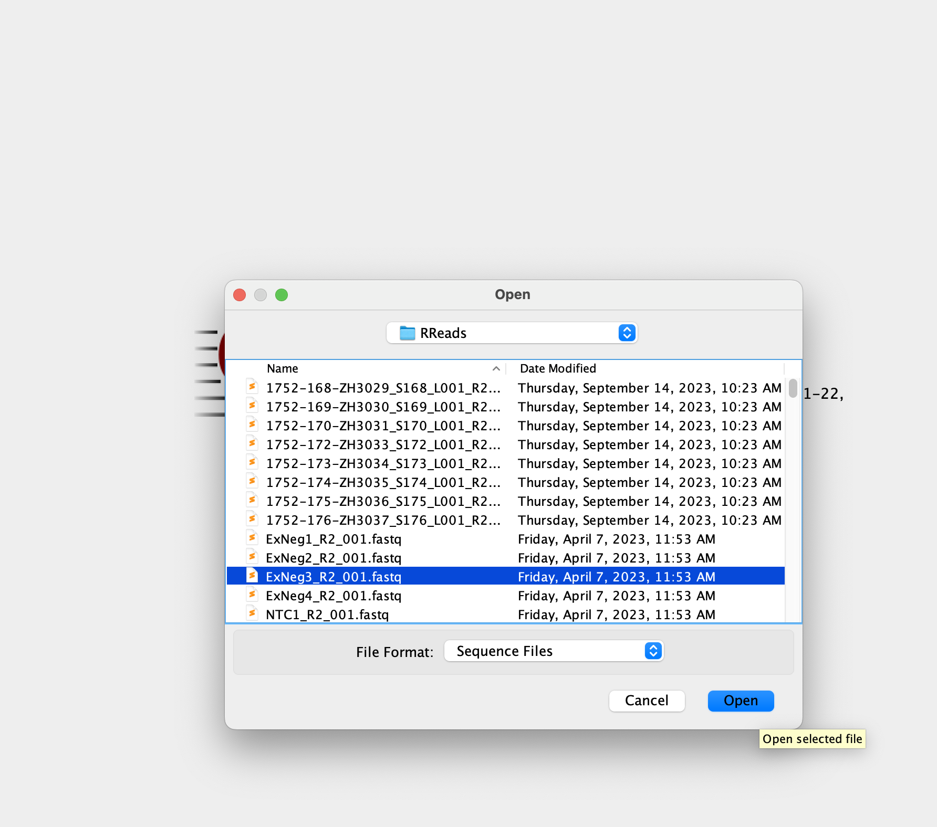
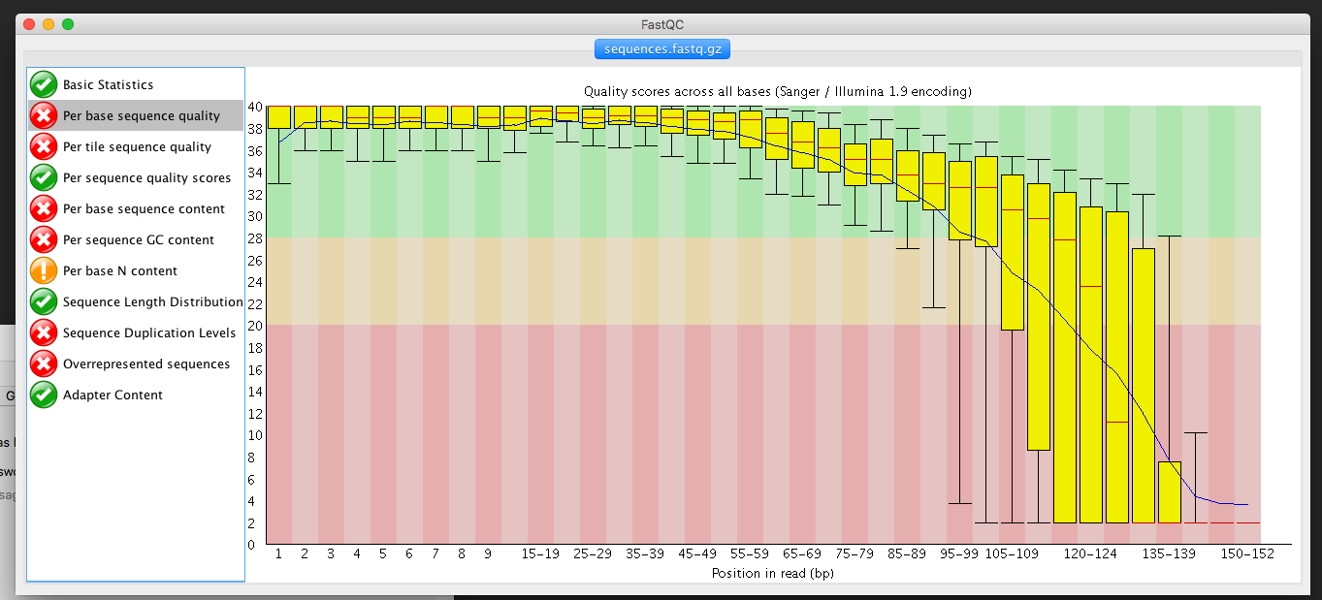
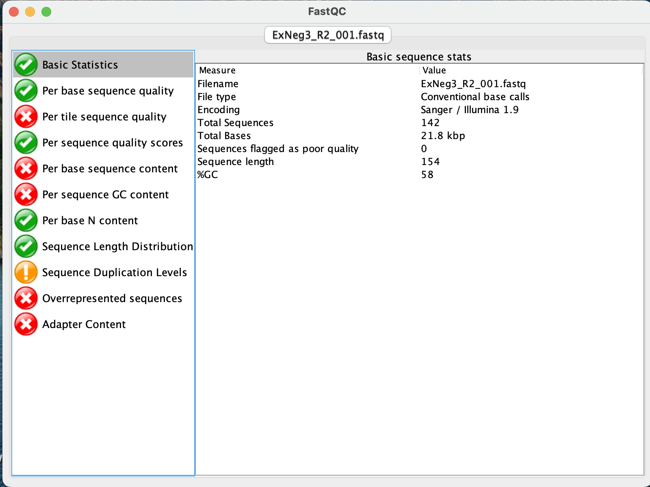

Slide 6
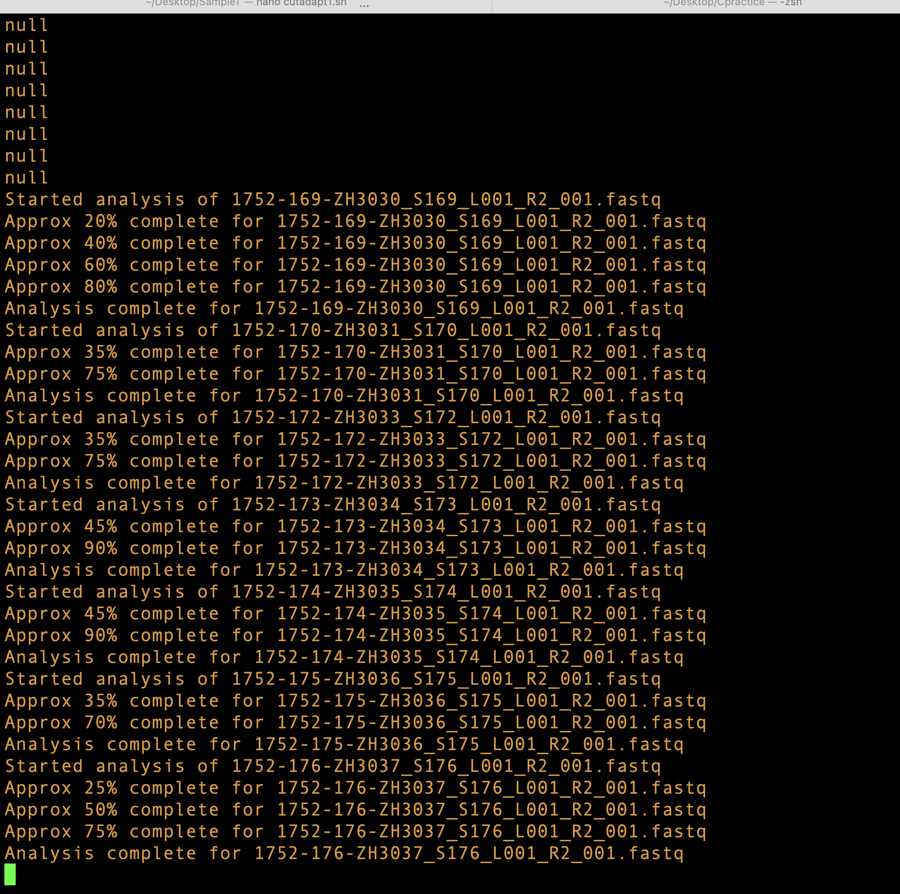
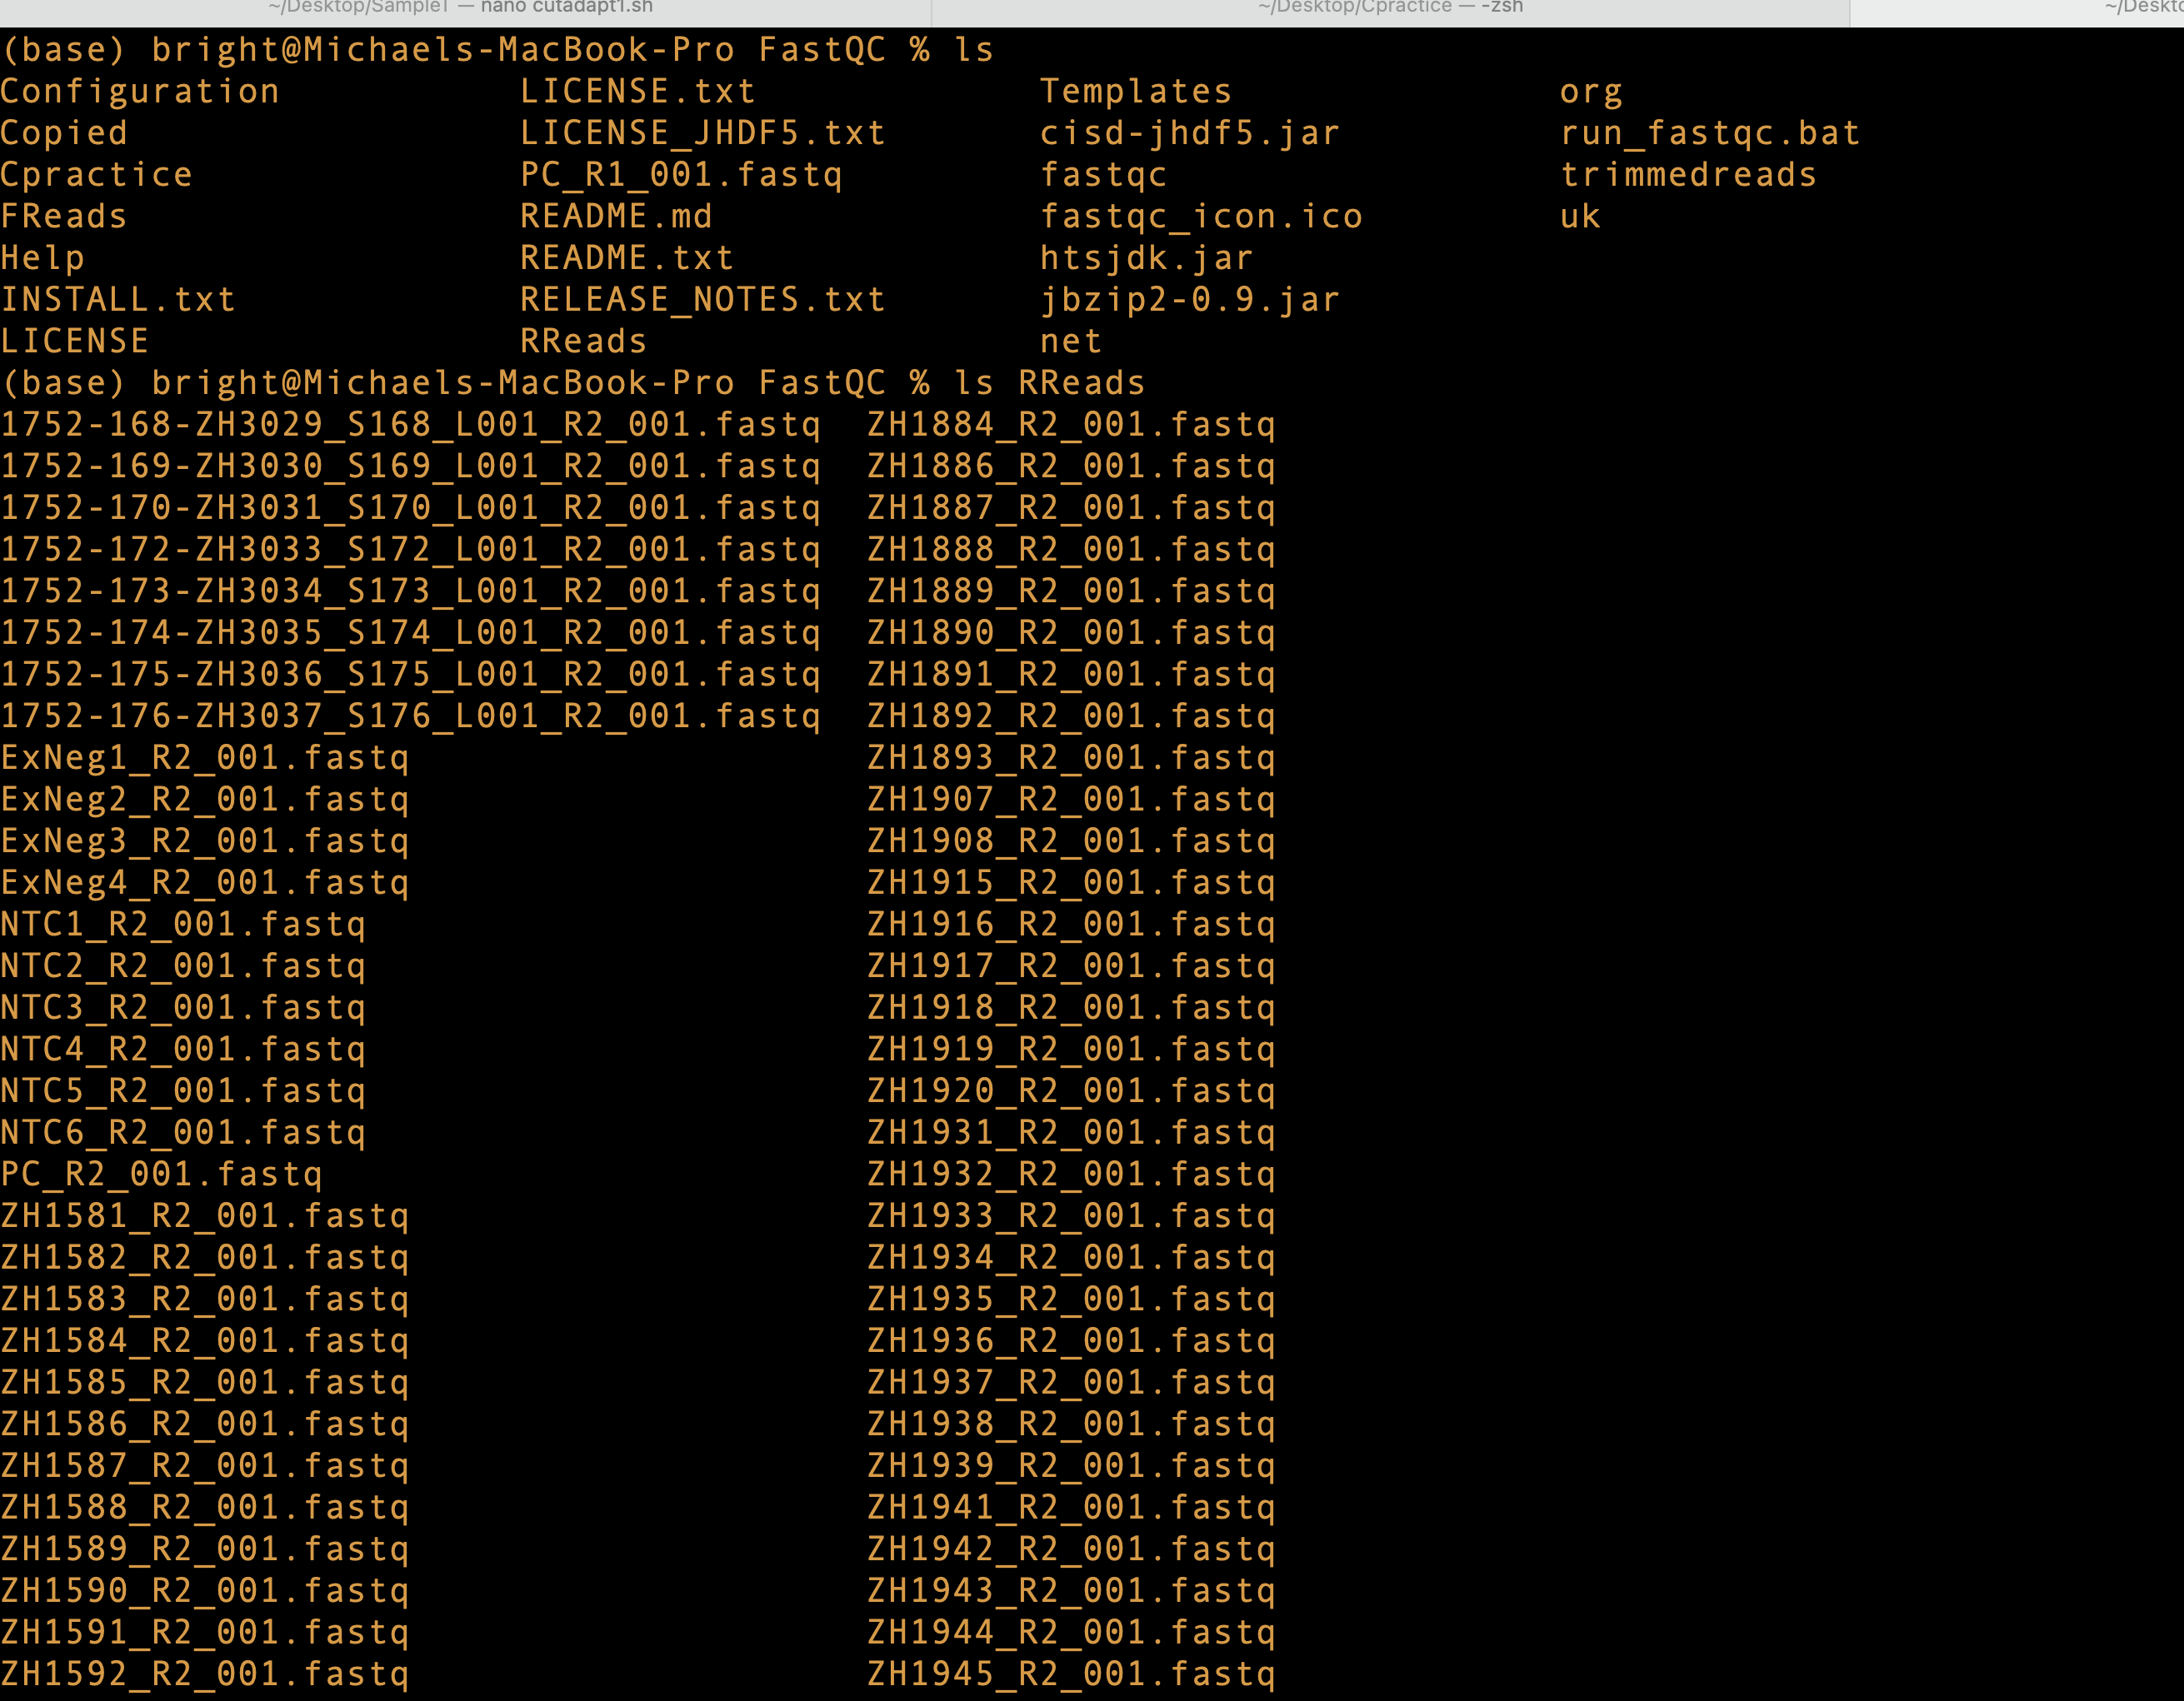
WHAT IF YOU HAVE MULTIPLE FILES?
(base) bright@MacBook-Pro FastQC % ./fastqc ./RReads/*.fastq

Slide 7








Output
Bad
Warning !!
Good
Median value
Interquartile range
Tips at ends = 10% and 90% points
Mean quality
So how do we make things better?

Slide 8
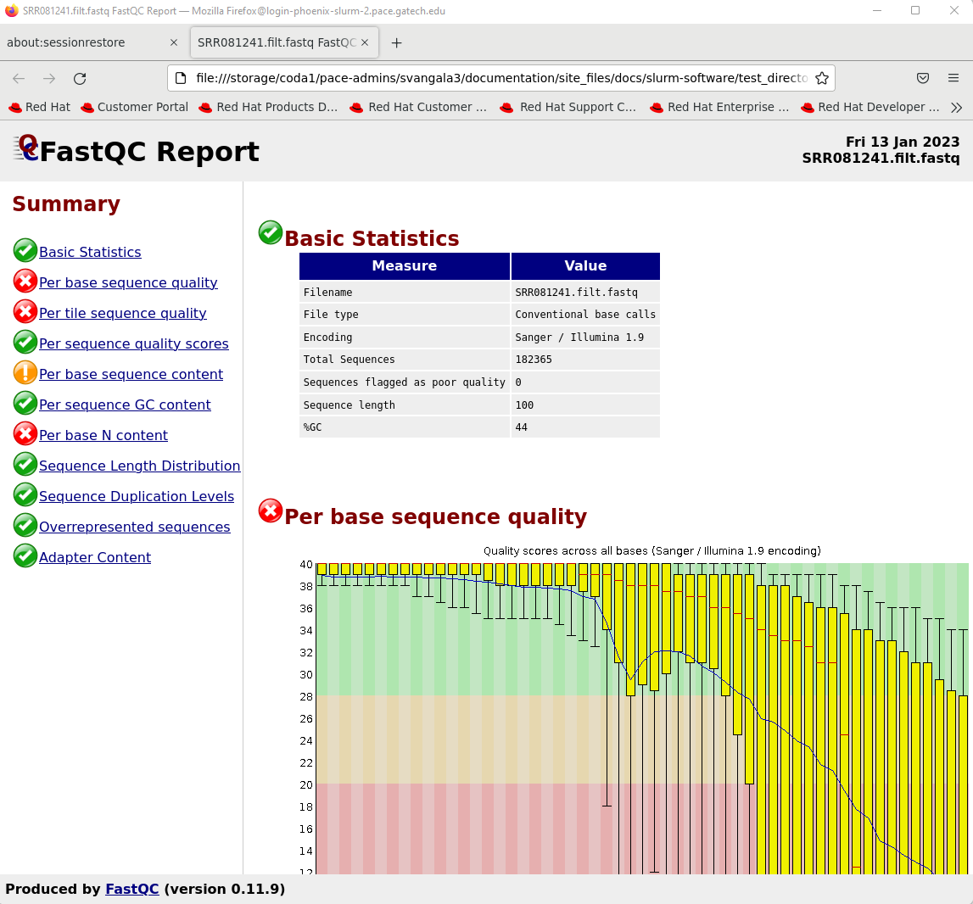
Per Base Sequence Quality Poor sequences can be trimmed off with trimming tools Cutadapt Trimmomatic Trim Galore
Poor
OK
Good

Slide 9
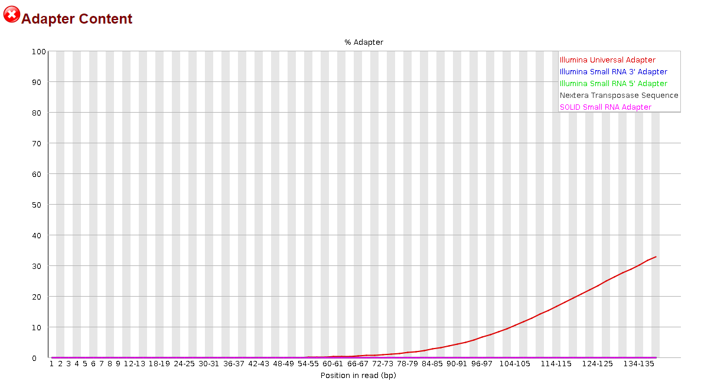
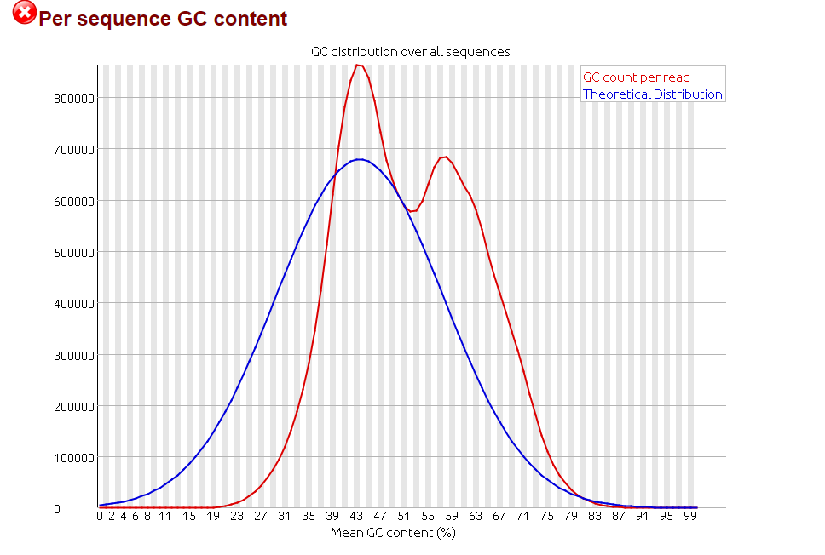

Slide 10
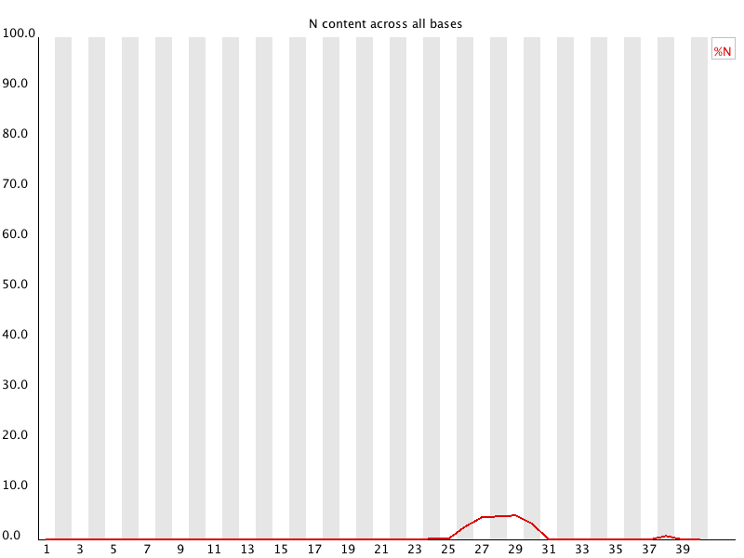
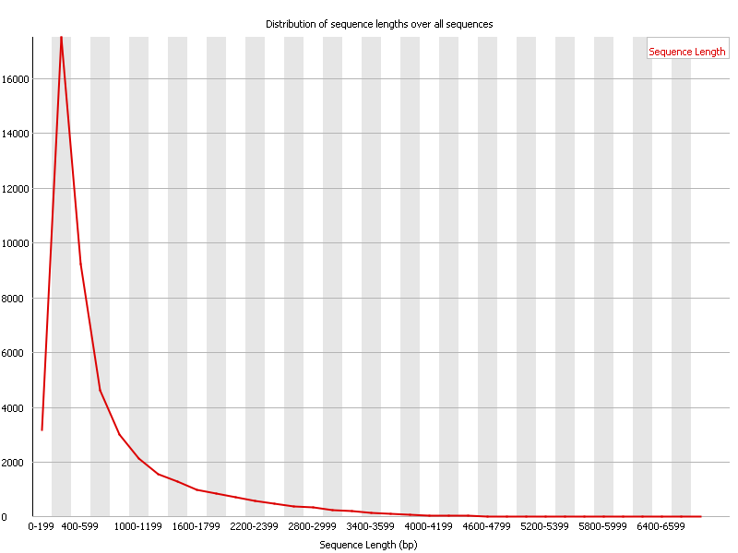
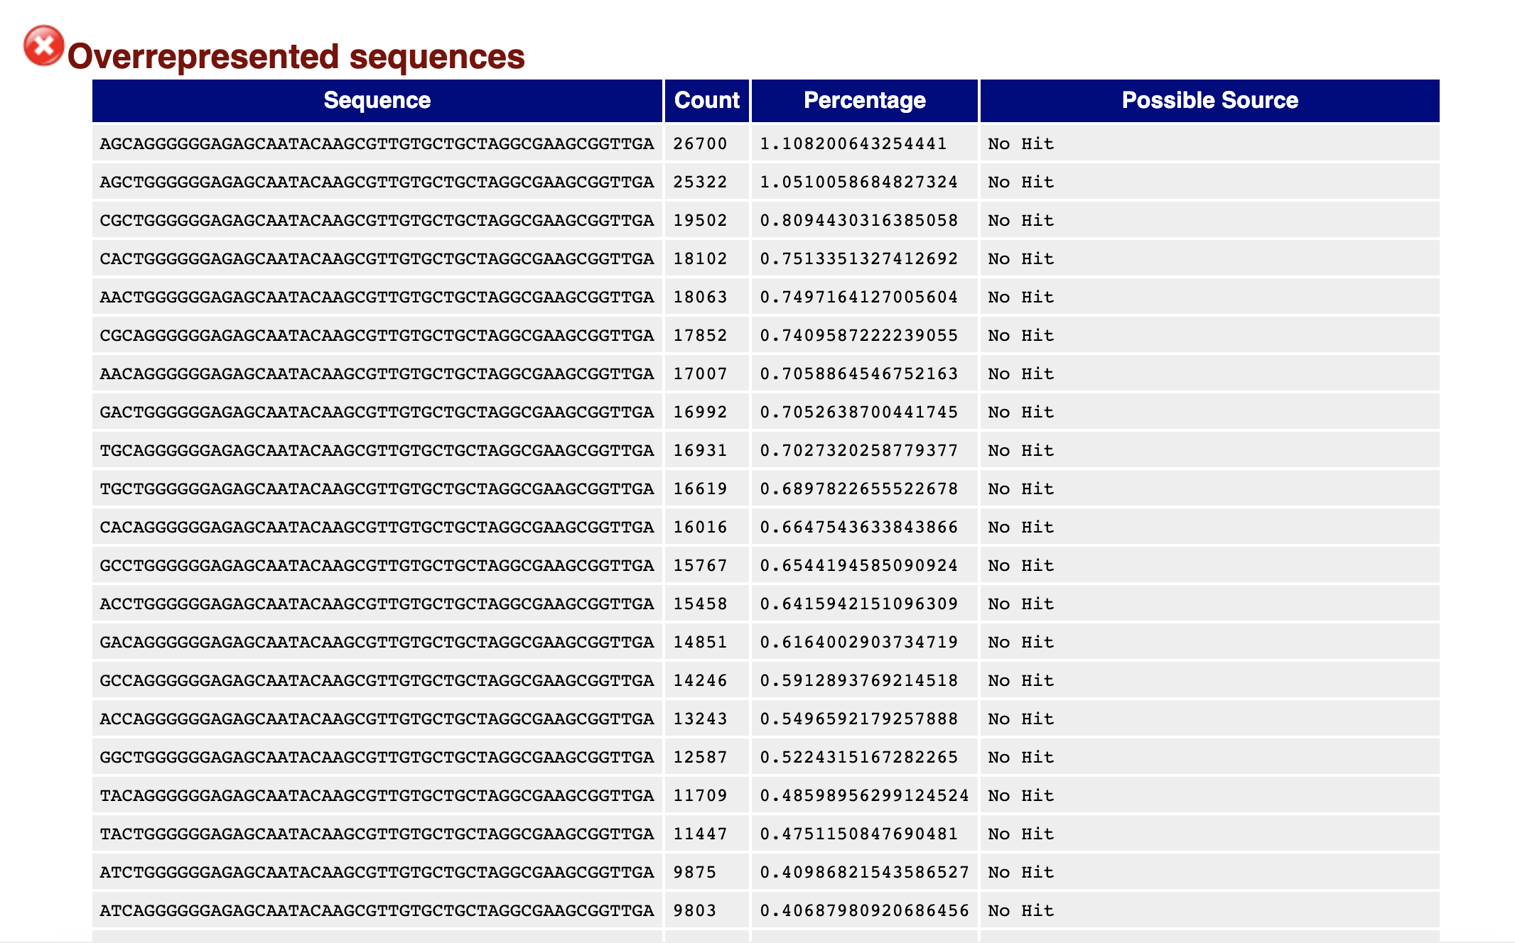

Slide 11


